Slide 1
Responsive Design
Flexible layouts and responsive pages

Slide 2
Display & Positioning
Display property: Controlling element behavior
block → Takes full width, starts on a new line (div, p).
inline → Stays in line with other elements (span, a).
inline-block → Inline but allows width/height (button, input).
flex → Flexible layout for 1D positioning (rows/columns).
grid → 2D layout system for complex designs.
Z-index: Controlling layer order
Higher z-index values bring elements forward.
Position property: Placing elements on the page
static → Default, follows normal document flow.
relative → Moves relative to its original position.
absolute → Moves relative to its closest positioned ancestor.
fixed → Stays in place, even when scrolling (e.g., sticky navbar).
sticky → Sticks until scrolling past a set point.
Smooth scrolling:
scroll-behavior: smooth;

Slide 3
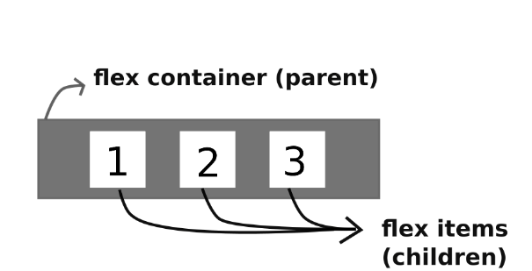

What is CSS Flexbox?
A layout method for arranging items in rows or columns.
Always consists of:
A Flex container – the parent (container) <div> element
Flex items – the items inside the container <div>
Example:
A Flexbox container with 3 flex items →
Flexbox Guide: https://css-tricks.com/snippets/css/a-guide-to-flexbox/

Slide 4

Parent properties

Slide 5
Children properties

Slide 6
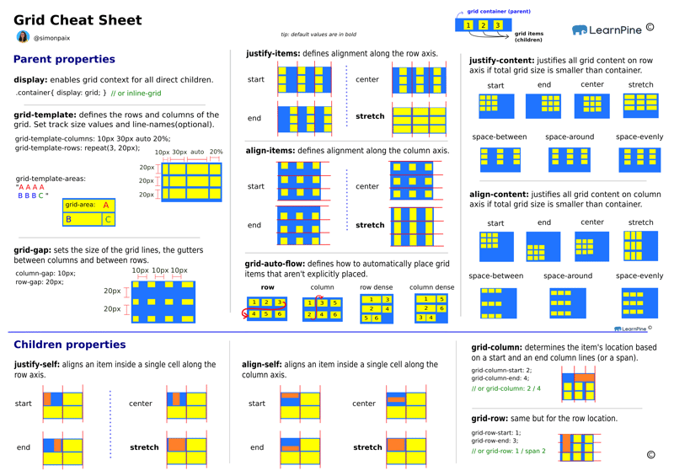
CSS Grid

Slide 7
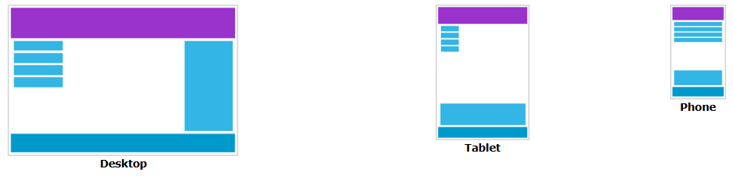
Responsive Design
Websites should adapt to different screen sizes.
Viewport:
The viewport is the user's visible area of a web page. It varies with the device.
Include the following element in the <head> section of all your web pages:
<meta name="viewport" content="width=device-width, initial-scale=1.0" />
→ Gives the browsers instructions on how to control the page's dimensions and scaling.

Slide 8
How to make a website responsive?
Use flexible layouts → Flexbox, flexible CSS (relative) units:
%
em – relative to previously defined element (1em = 100% of parent)
rem – relative to root font size (1rem = 100% of <html> font-size)
vw / vh – percentage of viewport width / height
Responsive media (max-width: 100%;)
Media queries → Adjust styles for different devices.

Slide 9
Device breakpoints
Mobile-first approach → Start with mobile styles first, then add breakpoints for larger screens.
body {
font-size: 16px; /* Default mobile size */
}
@media (min-width: 768px) {
body { font-size: 18px; } /* Tablet size */
}
@media (min-width: 1024px) {
body { font-size: 20px; } /* Desktop size */
}

Slide 10

Tasks for next week
Practice Flexbox: https://flexboxfroggy.com/#hu
Start using Flexbox on your own websites

